Slide 1
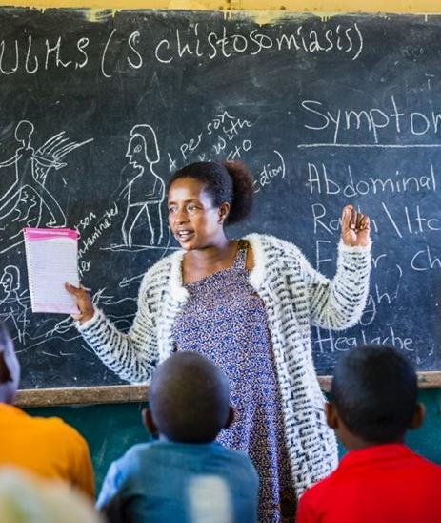
The Future of Combatting Neglected Tropical Diseases
Innovative Financing and Shared Global Responsibility
Workshop, World Health Summit, 13 October 2025
Johannes Waltz, Merck

Slide 2

We are a VIBRANT
SCIENCE & TECHNOLOGY
COMPANY
Who We Are | Merck 2025

Slide 3

Key figures
Founded
1668
+62,000
Employees worldwide
65
Countries
2.3
R&D (€ billion)
21.2
Sales (€ billion)
in 2024
Who We Are | Merck 2025

Slide 4
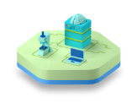
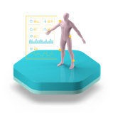
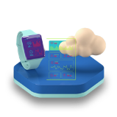
Expertise
Life Science
Healthcare
Electronics
Who We Are | Merck 2025

Slide 5
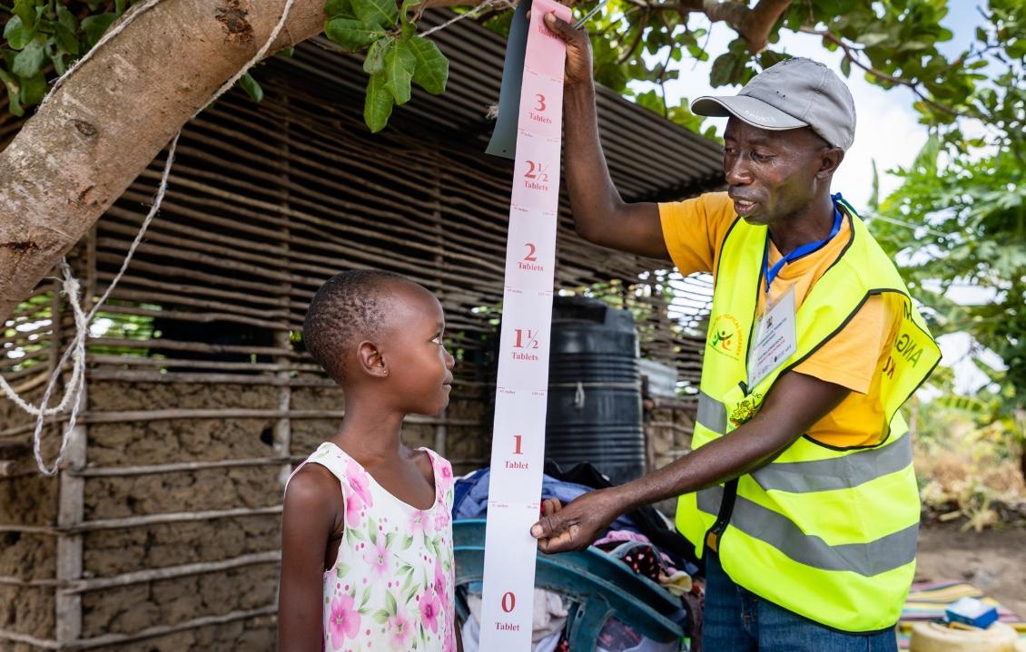

Committed to
Eliminating
Schistosomiasis
as a Public Health Problem
> 250 Million Cases worldwide
> 90%
of those affected live in sub-Saharan Africa
> 2 BILLIon
Praziquantel tablets provided since 2007
> 800 mILLIon
People, mainly school-aged children, treated with praziquantel
Source-WHO Factsheet at:
https://www.who.int/news-room/fact-sheets/detail/schistosomiasis

Slide 6
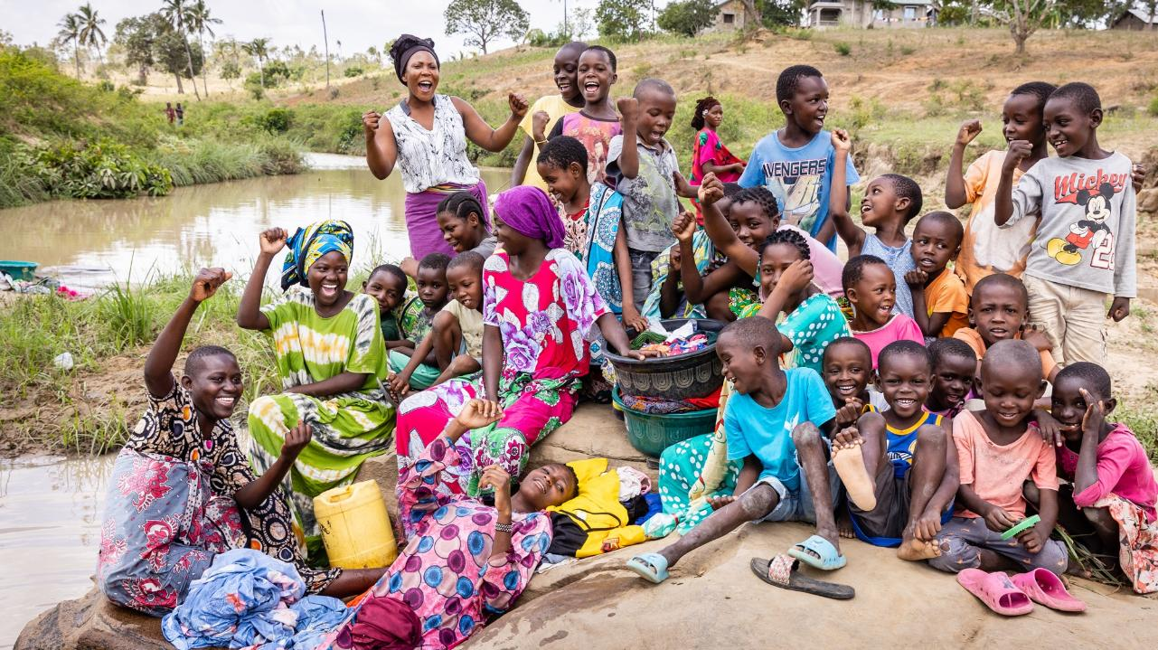

Praziquantel Program
Health Education +
Advocacy
& Partnership
Integrated approach
New Treatments
Women’s Health
Diagnostics & Co-Infections
Praziquantel & Arpraziquantel
Treating schistosomiasis across all age groups

Slide 7

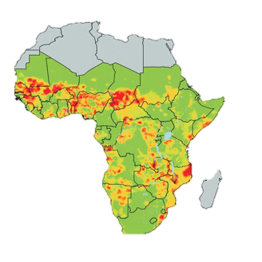
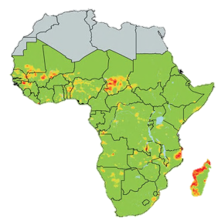
The prevalence
of schistosomiasis
in sub-Saharan Africa
has gone Down by
53-67% over the last
10 years*
2010
2019
* Source: The Lancet Infectious Diseases Volume; Issue 1; January 2022; Pages 136-149

Slide 8
Merck Schistosomiasis Franchise
Strategic Roadmap
A world free of Schistosomiasis
Vision
To eliminate schistosomiasis as a public health problem, achieve interruption of transmission, where feasible, and sustain control in endemic areas through an integrated approach. In doing so we combine sustainable access, health system strengthening, and innovation, while empowering partnerships with endemic countries and global stakeholders in alignment with the WHO NTD Roadmap.
Mission
2023 A2H projects.xlsx
Maintain control of schistosomiasis in high and moderate-prevalence areas through sustained treatment coverage, targeted advocacy, and government partnerships, ensuring reduced prevalence levels in these regions by 2030.
Eliminate schistosomiasis as a public health problem in selected endemic regions by 2030 through sustainable treatment and access, innovative solutions, and strong country partnerships.
Achieve interruption of transmission of schistosomiasis in selected regions by 2030 by driving treatment innovations, supporting national programs, and ensuring targeted interventions.
Long-term Objectives

Slide 9
Interim PZQ Risk Assessment for 2026
PZQ Program
Country | Risk Assessment
Burundi
Kenya
DRC
Liberia
South Sudan
Chad
Mauritania
Rwanda
Zanzibar
Angola
Malawi
Cambodia
Chad
Country | Risk Assesment
Burkina Faso
Mali
Senegal
Ghana
Benin
Guinea
Ethiopia
Niger
Senegal
Sierra Leone
Nigeria
Non USAID | PZQ Exp. 2026
Distributed | 21 688 810
Low risk | 23 026 425
Medium risk | 28 318 000
High risk | 2 200 000
Supplied | 75 233 235
USAID | PZQ - Exp. 2026
Distributed | 41 593 922
Low risk | 26 144 000
Medium risk | 9 559 078
High risk | 11 344 000
Supplied | 88 641 000

Slide 10
Integration for Neglected tropical diseases
The Future of Combatting NTDs
Integration for NTDs involves combining NTD interventions with broader health systems, programs, and public services to improve efficiency, coverage, and sustainability. This includes linking NTD efforts with primary healthcare, immunization, WASH (water, sanitation, and hygiene), and vector control
Key Integration Strategies
• Integrated Mass Drug Administration (MDA)
• Linking with Primary Healthcare
• WASH and NTDs
• Vector Control Synergies
• One Health Approach
• Integration with Immunization Campaigns

Slide 11
Integration for Neglected tropical diseases
The Future of Combatting NTDss
Integration for NTDs involves combining NTD interventions with broader health systems, programs, and public services to improve efficiency, coverage, and sustainability. This includes linking NTD efforts with primary healthcare, immunization, WASH (water, sanitation, and hygiene), and vector control
Key Integration Strategies
• Integrated Mass Drug Administration (MDA):
Delivering treatments for multiple NTDs simultaneously—such as lymphatic filariasis, soil-transmitted helminths, and schistosomiasis—reduces costs and increases coverage.
• Linking with Primary Healthcare:
Embedding NTD diagnosis and treatment into routine health services ensures continuity and sustainability. Ethiopia, for example, is mainstreaming NTD care into its primary healthcare system.
• WASH and NTDs:
Integrating water, sanitation, and hygiene programs with NTD control helps prevent diseases like trachoma and intestinal worms. WHO emphasizes WASH as a cornerstone of NTD prevention.
• Vector Control Synergies:
Coordinated efforts with malaria and dengue programs—such as insecticide-treated nets and environmental management—can reduce transmission of vector-borne NTDs like leishmaniasis.
• One Health Approach:
Recognizes the interconnectedness of human, animal, and environmental health. This is especially relevant for zoonotic NTDs like echinococcosis and rabies.
• Integration with Immunization Campaigns:
Joint delivery of vaccines and NTD treatments during outreach campaigns improves efficiency and community trust.

Slide 12
The Future of Combatting NTDs
Integration for Neglected Tropical Diseases
• Benefits of Integration
• Cost Efficiency: Shared logistics, personnel, and infrastructure reduce operational costs.
• Improved Coverage: Reaching underserved populations through existing health platforms increases access.
• Sustainability: Embedding NTD programs into national systems ensures long-term impact beyond donor cycles.
• Community Engagement: Integrated programs foster stronger relationships with communities and improve uptake.
• Challenges to Integration
• Governance and Coordination: Requires strong leadership and cross-sector collaboration.
• Financing Gaps: Integrated programs need flexible, multi-sectoral funding.
• Data and Monitoring: Harmonized systems are essential to track progress across diseases and sectors.
• Training and Capacity: Health workers need cross-cutting skills to manage multiple interventions.treatments and diagnostics.

Slide 13
The Future of Combatting NTDs
Innovative Financing Mechanisms
• Debt Swaps for Health
Countries restructure debt obligations in exchange for commitments to invest in health programs targeting NTDs. This model has gained traction in low- and middle-income countries where debt burdens limit public health spending.
• Development Impact Bonds (DIBs)
Private investors fund NTD interventions upfront and are repaid by donors or governments only if predefined health outcomes are achieved. This results-based financing encourages efficiency and accountability.
• Milestone-Based Funding for Diagnostics
Funding is released as developers hit specific technical or clinical milestones in creating diagnostic tools for NTDs. This model reduces risk and incentivizes innovation.
• Pooled Procurement
By aggregating demand across countries or regions, pooled procurement can shape markets, lower costs, and ensure consistent supply of NTD treatments and diagnostics.

Slide 14
The Future of Combatting NTDs
Moving from Pure Donation to Sustainable Investment
Social impact
We are moving to an integrated SCH investment strategy and actively mobilize local ecosystems to eliminate schistosomiasis in selected endemic African countries by 2030
We aim at integrated strategies that align GH departments, Merck business units, and external partners
Innovative solutions
Evolving from donation of 250M PZQ tabs p.a. to sustainable investment into a systems-level solution package
Treating the full age-range of schisto patients in order to move to elimination:
- Roll out of pediatric formulation
- Extension to adult treatment
- Optimized formulation (by 2027)
Develop digital tools to improve the last mile of our PZQ supply chain
Move to target treatment based on AI-supported modeling and new diagnostics (RDT)
Cross-sector engagement
Partnering with all relevant international stakeholders on schisto to accelerate elimination.
Achieving higher and measurable efficiency and impacting effectiveness with partners.
Moving to local systems engagement with co-owned elimination partnership plans, working with 2-3 focus countries on elimination that are conducive to collective action.
Move to Sustainainable Investment
Providing SCH treatment packages based on differentiated PZQ & arPZQ pricing approaches, from cost-free, to cost-price, to cost-price plus
Schisto Franchise role & activities
We increase the franchise’s effectiveness for elimination, and its sustainability all for S/Hs incl. Merck
Tangible business value/sustainable investment
Aiming at higher leverage of co-funders, cost-coverage contribution from, e.g. sale of PZQ to selected stakeholders and differentiated pre-SAC and adult tablet pricing model
Thought leadership for new co-funded partnership models
Value creation
Improve effectiveness and impact.
Main area of visibility for Merck, hence a commitment to upkeep program and show progress given Merck‘s giving history
(In)tangible value from social investment

Slide 15
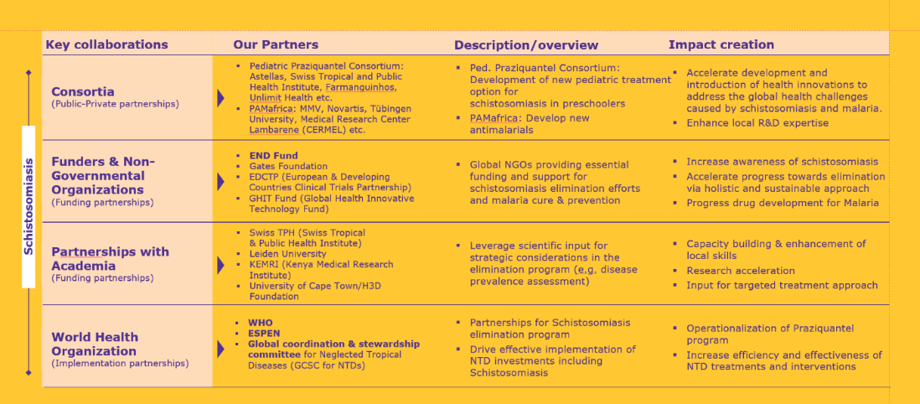
The Future of Combatting NTDs
Multi-stakeholder partnerships as a crucial lever
Increase awareness of schistosomiasis
Accelerate progress towards elimination via holistic and sustainable approach
Progress drug developments

Slide 16
T H A N K Y O U !

