Slide 1
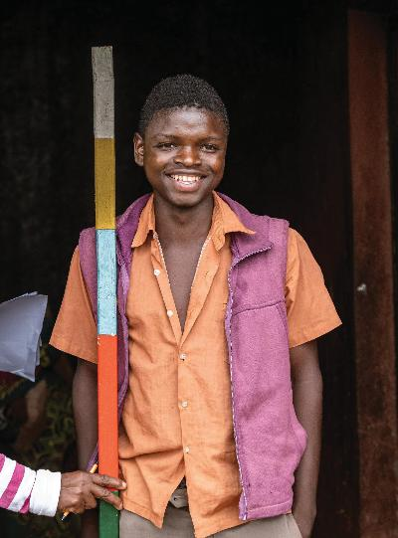
Sustaining success and accelerating elimination of neglected tropical diseases:
What is the role of philanthropy?
Dr Carol Karutu
October 13, 2025

Slide 2
The role of philanthropy
Philanthropy accelerates development by acting as a catalyst, connector, and innovator.
        Catalytic funding
        Filing gaps
        Capacity strengthening
    Driving change
    Leveraging partnerships
    Data, research and innovation
    Advocacy and Influence
BUT
Philanthropy cannot replace government, civil society, community, private sector etc.
end.org | December 2024

Slide 3
Example: Oromia Regional Health Bureau, Ethiopia
In 2024, a memorandum of understanding (MOU) was signed between the END Fund and the Oromia Regional Health Bureau
USD 2 million annual budget; 50/50 co-financing at USD 1 million per party
Program area | Description | Target | Achievement
Soil Transmitted Helminths (Population) | District | 77 | 233
 |  | 2,592,503 | 7,842,047
trachomatous trichiasis (TT) surgery | Training of surgeons | 25 | 20
 | Surgeries conducted | 1500 | 1204
WASH-NTD multi-sectoral coordination, One behavior change communication (BCC) package preparation and Dissemination Advocacy Regional NTD/STH steering committee
end.org | December 2024

Slide 4
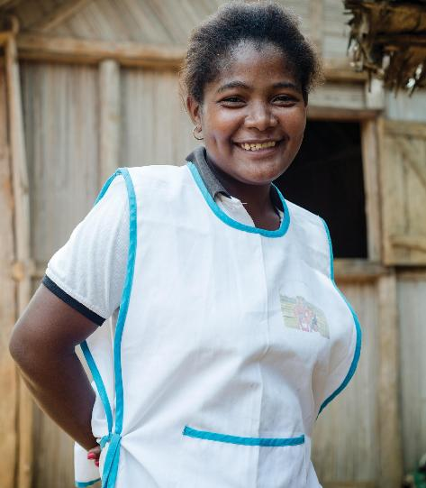
What we have learned so far…..
High-level advocacy to mobilize key decision makers –politicians- in addition to the health technocrats
Patience to co-create and trust the government partners know best during the planning and implementation phases
government was able to deliver TT surgeries in conflict areas that NGOs could not
government has the holistic overview of the health needs and could better identify integration opportunities.
Commitment from both parties to allocate budgets for the identified priorities and adhere to the terms of the MOU.
multi-year agreement instead of a one year agreement has higher possibility securing a long-term commitment of funding from the government.
  Monitoring of the intervention, including pooling of funds and expenditures must be agreed at the start.

Slide 5
What is next for civil society?
Pivot beyond donor-driven models and instead invest in partnerships rooted in trust, respect and mutual accountability.
Listen more; local expertise must shape, implement, monitor and take responsibility for the results
The fragile context of this moment allows us the opportunity to leapfrog incremental change, to boldly reshape a new era for public health financing.

Slide 6
THANK YOU
end.org | December 2024

Slide 7
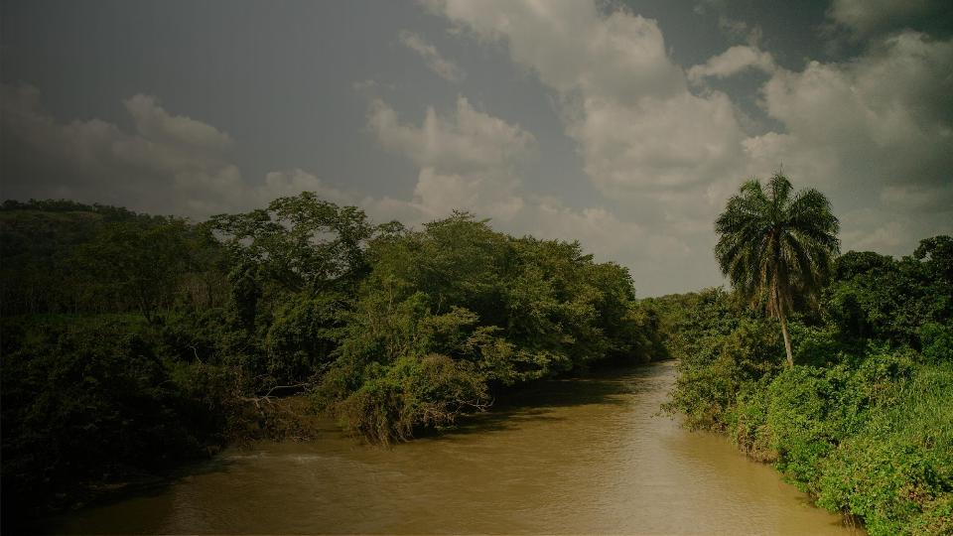
NEGLECTED TROPICAL DISEASES (NTDS)
NUMBER OF TREATMENTS
1.49B
NO. OF PEOPLE
AFFECTED BY NTDS GLOBALLY
100+
COUNTRIES REQUIRING TREATMENT
2.5M
PEOPLE REQUIRING SURGERY FOR
ADVANCED TRACHOMA
1.7B
PEOPLE REQUIRING TREATMENT
120K
ESTIMATE DEATHS PER YEAR
$86
COST PER PERSON TO PROVIDE SURGERY TO PREVENT BLINDNESS FROM TRACHOMA
$100
COST PER PERSON TO PROVIDE SURGERY TO CURE HYDROCELE
50¢
COST PER PERSON PER YEAR TO TREAT THESE DISEASES
|
end.org December 2024

Slide 8


Most Common NTDs
Intestinal
Worms
Hookworm, roundworm and whipworm, which live in the intestines and cause malnutrition,
anemia, stunted growth, and impaired cognitive function.
914M children require treatment.
Lymphatic Filariasis (Elephantiasis)
Parasitic roundworms infect the lymphatic system, causing it to function improperly, leading to fluid buildup and severe swelling.
794M people in need of treatment.
River Blindness
(Onchocerciasis)
Schistosomiasis (Snail Fever)
A chronic disease caused by parasitic worms and contributes to stunted growth, impaired cognitive development, and malnutrition in children.
251M people in need of treatment.
Trachoma
Visceral Leishmaniasis
Visceral leishmaniasis, also known as kala-azar, is a life-threatening parasitic disease, transmitted by female sandflies.
50K–90K annual life-threatening cases
An eye and skin infection caused by parasitic worms that leads to extreme itching, rashes, skin nodules, and vision impairment.
244M people in need of treatment.
A bacterial infection of the eye that causes blindness.
116M people in need of treatment.

