Slide 1
World Health Summit 2025
The Future of Combatting Neglected Tropical Diseases: Innovative Financing and Shared Global Responsibility
Monday, October 13, 2025
Laurent Fraisse, R&D Director

Slide 2
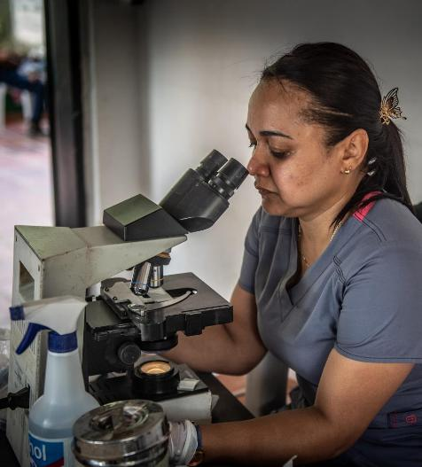
World health Summit 2025
What current challenges does research for NTDs have to overcome?
Rapidly changing global health environment
R&D funding for NTDs declining
Prioritization in national health strategies of affected countries
Long drug development timelines and high attrition rates hampered more by limited funding
Lack of alignment and coordinated approaches among R&D funders
Gaps in scientific knowledge and data, use of AI technologies
Transformation of the pharmaceutical innovation model

Slide 3
World Health Summit 2025
Evolution of the number of DNDi partnerships with large multinational pharmaceutical companies on R&D projects
Notes:
Astra Zeneca – screening STH and schisto in 2012, Booster in 2015
Bayer MTA in 2007, testing compounds, in mice; EMO
GSK – GSK/Dundee/DNDi CA agt in 2018, continues 245, 6899 until Ph1 (2020 CA); transfers ownership of 6899 to DNDi (2023)
Roche – MTA testing compounds in 2005, 2007
Shinogi – screening Chagas agt in 2025 (GHIT), 2018 MTA w GARDP (neosepsis)
Discovery Booster - AbbVie, Astellas, AstraZeneca, Celgene (now part of Bristol-Myers Squibb), Eisai, Merck, Shionogi, and Takeda
Notes from Charlie:
Eisai – access to compounds in 2009
Astellas - discovery started in ~2011 as well as the booster later
BMS - screening in about 2014
GSK - Our partnership had already started when I joined in 2011
Merck USA - screening ~2012-2016 see BEST plan and HAMMAR deck projects
Mitsubishi Tanabe is on-going ON LO with GHIT. Although M-T just sold to a VC.
Pfizer screening about 2010-2015 provided the hit that became the aminopyrazole series and ended up as LO with Taked and PC dev with GHIT. As well as the Anacor licences.
Takeda ~ 2015-2017 much more than just the Booster. Screening of their own library plus later collaboration on aminopyrazole series mentioned above.
Merck KGaA – RSA (Cz008) in 2008, Mini library agt in 2014, MTA Open GH library in 2020

Slide 4
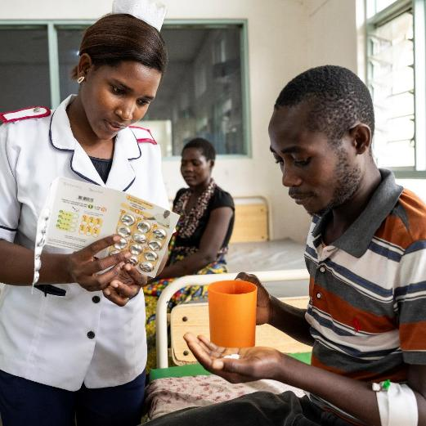



World Health Summit 2025
How can we overcome these challenges and bring medical innovation to neglected patients?
Keep patients at the centre of R&D
Develop new partnerships to diversify the ecosystem
Strengthen advocacy efforts for NTDs
Demonstrate the value of R&D
Promote end-to-end support across the entire pharmaceutical value chain

Slide 5




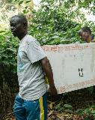
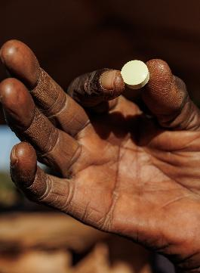

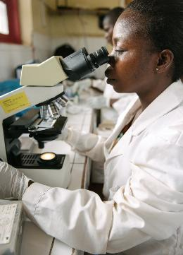



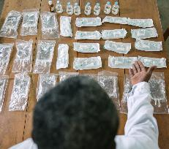

World Health Summit 2025
Delivering breakthrough treatments and expediting access
15 YEARS AGO
2009
2018
2023
GOAL
MELARSOPROL
NECT
FEXINIDAZOLE
FEXINIDAZOLE
for r-HAT
ACOZIBOROLE
‘Fire in the veins’
Effective and safe but hospital-based and complex logistics.
All-oral. Once a day for 10 days for T.b. gambiense.
EMA positive opinion
Dec 2023
An innovative single-dose oral treatment to sustain elimination

Slide 6
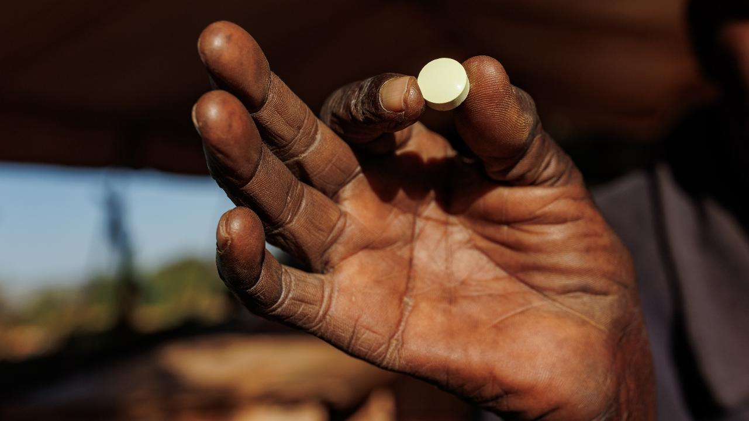
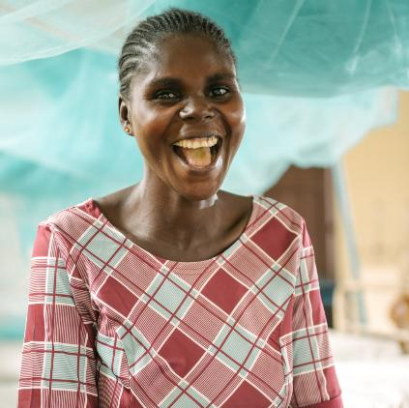



THE POWER OF PARTNERSHIP
A PATIENT-NEEDS DRIVEN ALTERNATIVE R&D MODEL IS POSSIBLE
NATIONAL PROGRAMMES AND MINISTRIES OF HEALTH
DONOR SUPPORT

Slide 7
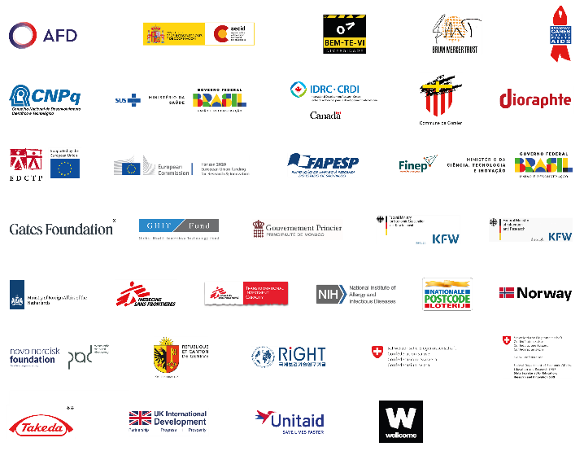
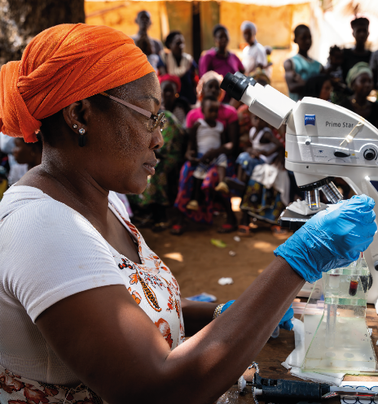
We thank every DNDi supporter for their contribution to advancing our mission and are deeply grateful to the following major donors for sustaining our progress in 2024:
THANK YOU
for your support
* Support to HAT & onchocerciasis
** Support to NTDs Access
We are also grateful to the following major donors for their generous support: Bennett Shapiro & Fredericka Foster,
The Broder Family Foundation, Mr. Clifford N. Burnstein & Ms. Sabra C. Turnbull, George H. Stout, Jeffrey Nelson, Perpetual Kindness Foundation, The Stainman Family Foundation, and other generous major donors who wish to remain anonymous.

Slide 8
